Slide 1


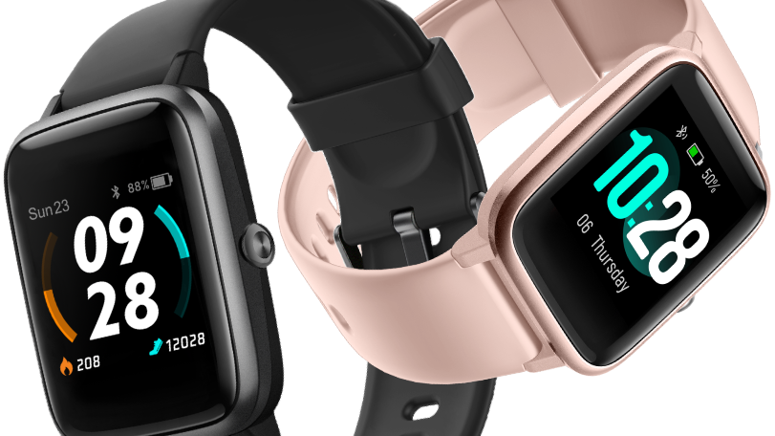
The smart watch situation in today’s world
Made by: karácsony zoltán

